Slide 1
Cervical Diagnosis
& treatment
By: Laura Jabczenki

Slide 2
Cervical Anatomy
OA – Occiput on Atlas (C1)
  Allows flexion and extension
  “Yes” joint
AA – Atlas (C1) on Axis (C2)
  Accounts for 50% of cervical spine rotation, no sidebending
  “No” joint
Important Ligaments: Transverse Ligament, Cruciate Ligament, Alar Ligaments
  All of these strengthen the connection between the occiput, C1, and C2 and allow for stability
*If you mix up atlas and axis, remember aTlas is on Top

Slide 3
Cervical Anatomy
C1 & C2 have atypical vertebral bodies and articulations
  Rotate and sidebend opposite with flexion or extension
C3-C7 have typical vertebral bodies and articulations
  Fryettes 2nd Principle – Rotation and SB occur in the same direction with flexion or extension
  Joints of Lushka - lateral joints involving the uncinate processes found on the vertebral bodies
Important Ligaments – Anterior Longitudinal Ligament, Posterior Longitudinal Ligament, Ligamentum flava, Supraspinous and interspinous Ligaments
  All of these strengthen the cervical spine and allows maintenance of joint and disc integrity

Slide 4
Cervical Nerves
The cervical plexus
  C1-C8 even though there are only 7 cervical vertebra
  C1 nerve exits above C1 vertebra, C8 nerve exits below C7 vertebra
Brachial Plexus
  C5-T1
  Passes between the Anterior and Middle Scalene
  Roots/Trunks/Divisions/Cords/Branches

Slide 5
Cervical Muscles
Trapezius – stabilizes and elevates the scapula
Levator Scapulae – elevates and medially rotates the scapula
Splenius Capitus and Cervicis – Extend the head
Scalenes – Sidebends the neck to the same side and elevates the 1st or 2nd rib
SCM – Flexes and rotates the head to the opposite side

Slide 6
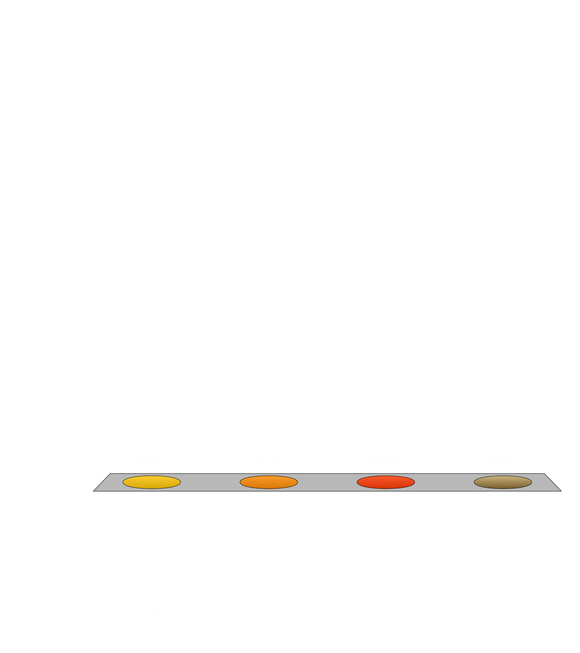
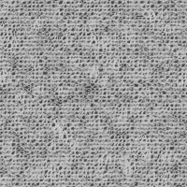
Rupture of the Transverse Ligament is more likely to occur in all of the following conditions EXCEPT…
Rheumatoid Arthritis
Cancer
Down’s Syndrome
Neck Fracture

Slide 7
The integrity of this ligament is essential to prevent catastrophic damage to the spinal cord
The transverse ligament supports atlas as it rotates around odontoid process
Rupture can occur in a weakened state from:
  Rheumatoid Arthritis
  Down’s syndrome
  traumatic injuries such as fractures

Slide 8
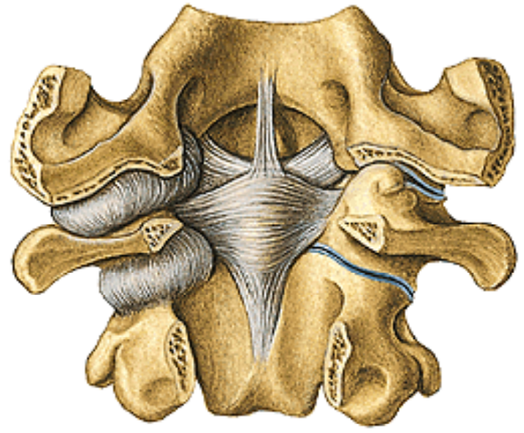
Transverse ligament

Slide 9
Which of the following explains a function of the joints of Lushka?
Restricts Sidebending
Assists in Sidebending
Reduce the risk of herniated nucleus pulposus
Restrict Flexion and Extension

Slide 10
The Structure of which of these Ligaments causes the greatest concern for disc herniation?
Ligamentum Flava
Anterior Longitudinal Ligament
Interspinous Ligaments
Posterior Longitudinal Ligament

Slide 11
Which of the following muscles is the prime head extensor?
Splenius
Semispinalis
Rectus Capitis Posterior Major
Obliquus Capitis Superior

Slide 12

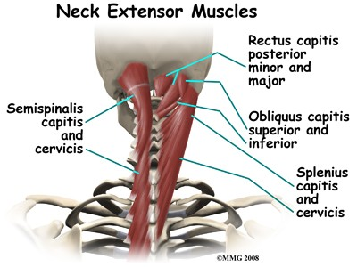
Splenius cervicis
Splenius capitus
Both are the prime muscles of extension for the head

Slide 13
All of the following statements are correct EXCEPT…
The middle Scalene is attached to the 2nd rib
The SCM is innervated by the spinal accessory nerve
The anterior scalene is attached to the 1st rib
The trapezius is innervated by CN XI

Slide 14
Your Patient’s Left SCM is extremely tight and contracted. Which patient presentation could you expect?
Their neck is rotated left
Their neck is flexed and rotated left
Their neck is flexed and rotated right
Their neck is rotated right

Slide 15
Your patient comes in and you ask them to perform different active gross motion tests. Which of the following would not be considered a normal gross motion ?
The head can extend more than it can flex
Your patient can sidebend their neck 55°in either direction
Your patient can flex/extend their neck a range of 130°
Your patient can rotate their neck 85°

Slide 16

Gross cervical Ranges of Motion
Flexion/extension 130 degrees
SB (lateral flexion) 35 & 35 deg.
Rotation 80-90 degrees R & L
Typical segmental motions
  Typical: C2-7 with motion
  C0-C1 (occiput-atlas) the “YES” joint
  C1-C2 (atlas-axis) the “NO” joint

Slide 17
There is a stenosis of the intervertebral foramen between the C6 and C7 vertebrae. Which spinal nerve would be affected?
C5
C6
C7
C8

Slide 18
If C6 is extended, rotated left and side bent left, what is this segment’s barrier?
ERSR
FRSL
ERSL
FRSR

Slide 19
You are testing the C5 spinal vertebra and realize that it will not fully extend and when you rotate it towards the right you feel restriction. How would you name this dysfunction?
C5FSRL
C5FRSL
C5ERSR
C5FRLSR

Slide 20
You are motion testing the OA and discover that it has restricted motion during left translation. In addition translation becomes easier when the head is flexed. What is your diagnosis?
FRRSR
FRLSL
FRLSR
FRRSL

Slide 21
Which of the following segments’ major motion is rotation?
C4
C5
C6
C7

Slide 22
Segment | Main Motion | Sidebending and Rot’ n
OA | Flexion and Ext’n | Opposite sides
AA | Rotation | Opposite sides
C2-C4 | Rotation | Same sides
C5-C7 | Sidebending | Same sides

Slide 23
Your patient has been thrown from his motorcycle and landed upside down on his shoulder/neck region. He has come to you for some relief and is seeking manipulation. How should you respond?
Provide counterstrain to help relax the muscles in the region
Provide HVLA to pop the vertebrae back into place
Order X-Rays or a CT before proceeding
Refuse to treat because you don’t believe he should be riding a motorcycle

Slide 24
When determining the range of motion and segmental dysfunction of the AA…which of the following steps do you not want to take?
have your patient supine with the physician at the head of the table
Have your fingers contacting the lateral masses of the Axis
Flex the cervical spine to 45° in order to lock out C2-7
Rotate the head in either direction to access freedom of motion

Slide 25
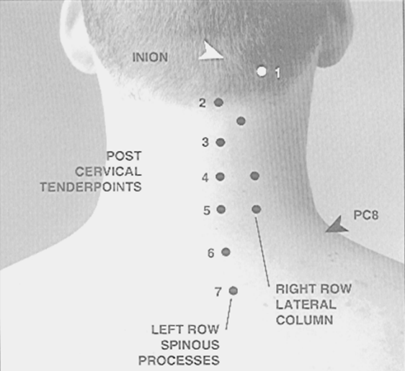
Posterior TENDERPOINTS!
Location:
Tender points are found bilaterally along the spinous processes, half a centimeter or less from the midline.
Tender points may also be bilateral, located posterolaterally along the articular pillars (see below, ‘’right row lateral column’’).
PC3 is located on the inferior aspect of C2 spinous process bilaterally.
PC4 is located on C3 spinous process bilaterally.

Slide 26
Posterior Tenderpoint Tx:
Most are treated with Extension, Sidebending Away, and Rotation Away from the tender point. (E SARA).
2. PC3 is the only exception requiring Flexion to treat hypertonic scalene muscles. (F SARA).

Slide 27
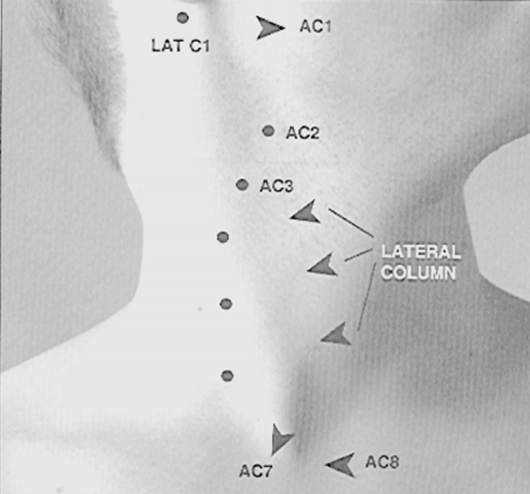
Anterior Tenderpoints
Locations:
1. Tender points are found bilaterally along the anterior surface of the articular pillar on their corresponding vertebra.

Slide 28
Treatment of Anterior Tenderpoints
Treatment:
1. Most are treated with Flexion and Sidebending Away and Rotation Away from the tender point (F SARA).
2. A1C is treated with marked rotation away only.
3. A3C and A7C are treated with Flexion Sidebending Toward and Rotation Away (F STRAW).

